Slide 1


New World Order: Challenges Facing Kenyan Society
Kenya, like many other countries, is facing numerous challenges in the new world order. These challenges arise from global interconnectedness and its impact on local contexts. Understanding these challenges is crucial for creating a sustainable future.

Slide 2
Communism: Ideology and its Impact
Communism
Impact on Kenya
Challenges
Communism is a political and economic ideology advocating for classless society with common ownership of resources.
While Kenya has never adopted communist rule, it faced its influence during the Cold War, leading to political and social movements.
Communism's emphasis on collectivism may clash with Kenya's existing social structures and individual aspirations.

Slide 3

Human Trafficking: A Growing Concern
1
Exploitation
Human trafficking exploits individuals for forced labor, sexual exploitation, or organ harvesting, often driven by poverty and lack of opportunities.
2
Vulnerability
Kenya, with its diverse demographics and economic disparities, faces significant vulnerabilities to human trafficking, impacting both domestic and international movements.
3
Consequences
Human trafficking can result in psychological trauma, physical harm, and social marginalization, perpetuating a cycle of exploitation and vulnerability.
4
Response
Combating human trafficking requires a multi-pronged approach, including law enforcement, victim support, and addressing the underlying root causes of vulnerability.

Slide 4

Food Sovereignty: Ensuring Access and Sustainability
1
Challenges
Climate change, poverty, and market fluctuations pose significant threats to food security and affordability in Kenya.
2
Food Sovereignty
Food sovereignty empowers local communities to control their food systems, ensuring access to safe and nutritious food.
3
Sustainable Practices
Promoting sustainable agricultural practices like agroforestry and rainwater harvesting enhances food production and ecological balance.
4
Community Empowerment
Empowering farmers with knowledge, resources, and market access strengthens their role in food production and distribution.

Slide 5

Misinformation: The Spread of False Information
Digital Age
The internet has democratized information but also amplified the spread of misinformation, with profound social and political implications.
Impact on Society
Misinformation can erode trust in institutions, fuel social divisions, and hinder informed decision-making, impacting public health and social cohesion.
Combating Misinformation
Developing media literacy skills, promoting fact-checking initiatives, and fostering critical thinking are crucial for navigating the digital landscape.

Slide 6
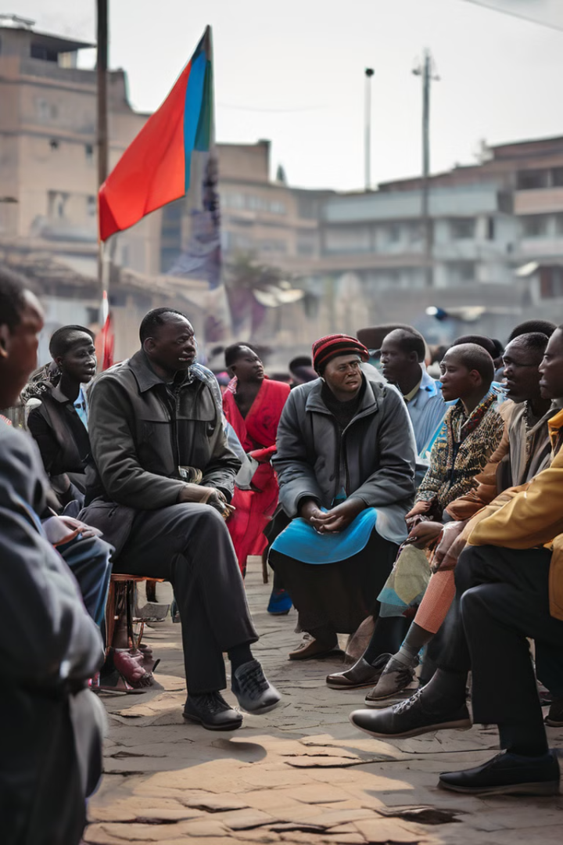




Effects of Communism on Kenyan Society
Political Influences
The Cold War brought about political tensions and ideological debates, with some Kenyans embracing communist ideas.
Social Movements
Communist ideas inspired labor movements and social justice activism, advocating for workers' rights and equitable distribution of resources.
Economic Policies
While communism never became dominant, its ideals influenced certain economic policies, promoting state ownership and social welfare programs.
Legacy
The influence of communism continues to shape debates about economic equality, social justice, and the role of the state in Kenyan society.

Slide 7

Combating Human Trafficking: Strategies and Initiatives
Strengthening Laws
Enacting and enforcing comprehensive legislation to criminalize human trafficking and protect victims' rights.
Law Enforcement Cooperation
Collaboration between national and international agencies to dismantle trafficking networks and prosecute perpetrators.
Victim Support Services
Providing safe shelters, legal aid, medical care, and psychosocial support to survivors of human trafficking.
Public Awareness Campaigns
Raising awareness about the dangers of human trafficking and empowering communities to identify and report suspicious activities.

Slide 8





Promoting Food Sovereignty and Addressing Misinformation
Sustainable Agriculture
Media Literacy
Community Engagement
Inter-Agency Cooperation
Empowering individuals with critical thinking skills and fact-checking tools to combat the spread of misinformation.
Promoting environmentally friendly farming practices to increase food production and ensure long-term food security.
Fostering community dialogues and participatory decision-making processes to address food security and misinformation challenges.
Enhancing collaboration between government agencies, civil society organizations, and private sector actors to address complex challenges.

